Slide 1
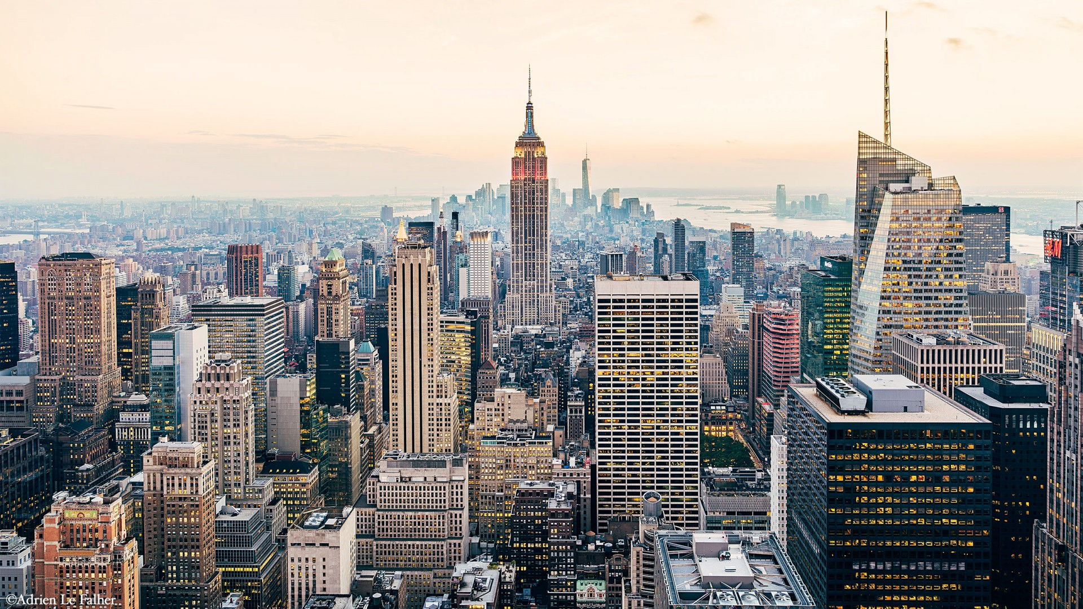
TOP OF THE ROCK
GROUP #5
Rasmus Christensen
Mikkel Johansen
Simone Patuelli
Simone Schiano

Slide 2







TIMELINE
INTRODUCTION
ISSUES
BUSINESS MODEL
Top Of The Rock case.
Understanding current issues of the case.
Designing solutions using a user-centered approach.
DATA ANALISYS
PROTOTYPES
QUESTIONS
Prediction and forecast related to our problem.
VR application & website.

Slide 3
INTRODUCTION

Slide 4
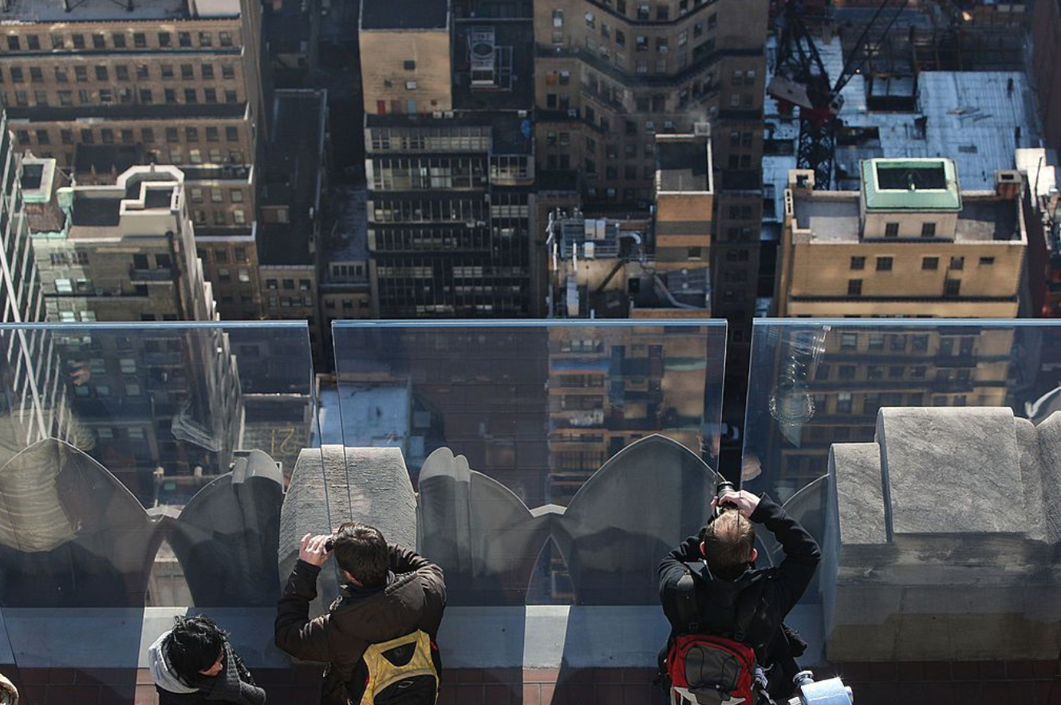
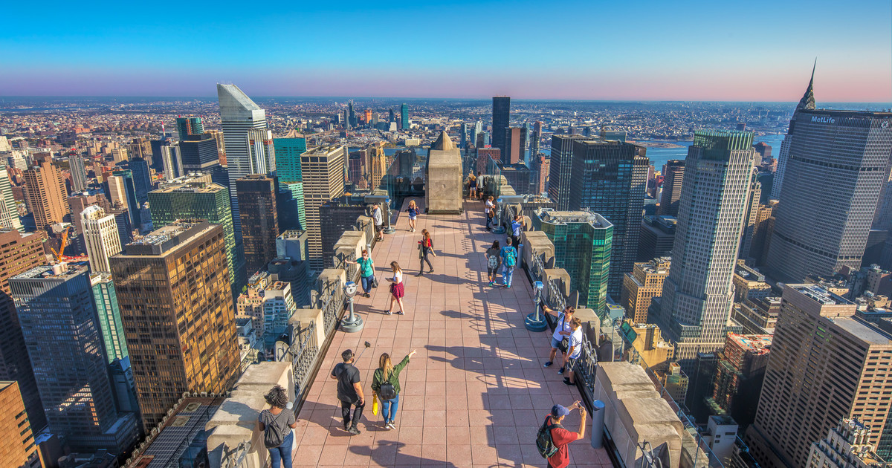
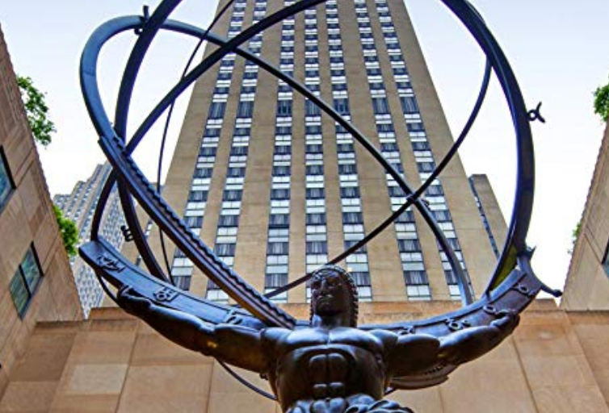
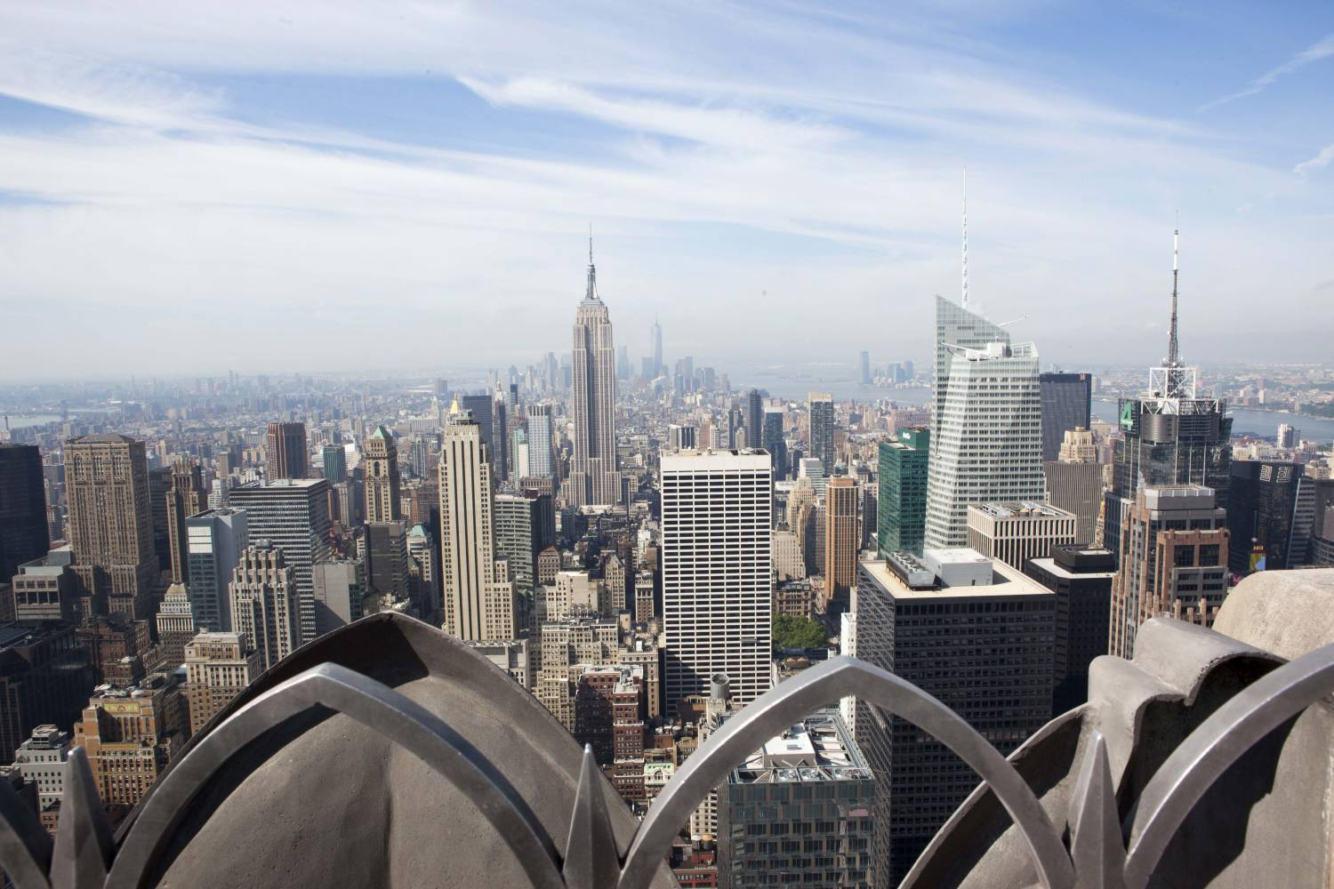
INTRODUCTION
The observation point in the upper part of Rockefeller Center
It offers a 360-degree view of New York City
Open for public in 1933 and is the 9th highest build in New York
From top of the rock you are able to see:
Empire State building,, Central Park, Times Square, etc.

Slide 5

ISSUES

Slide 6
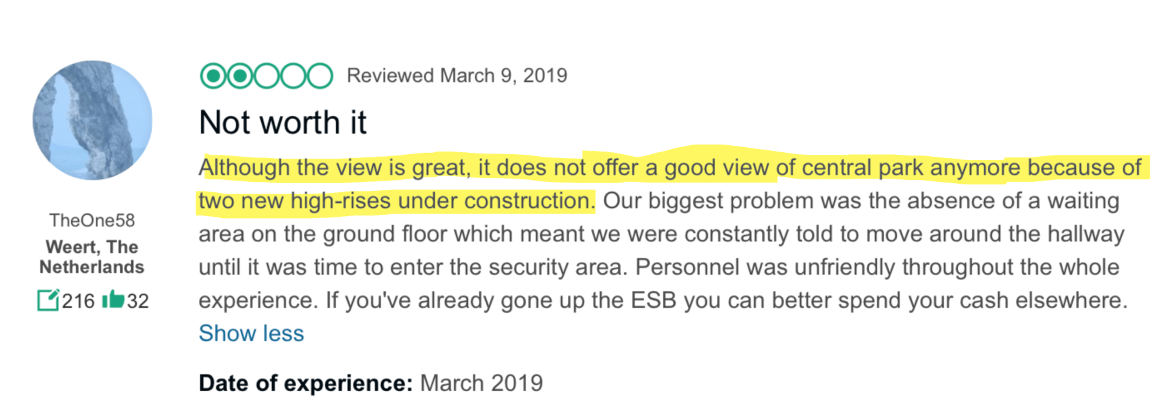
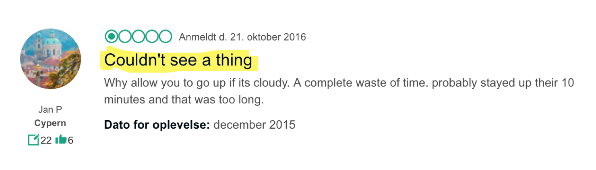
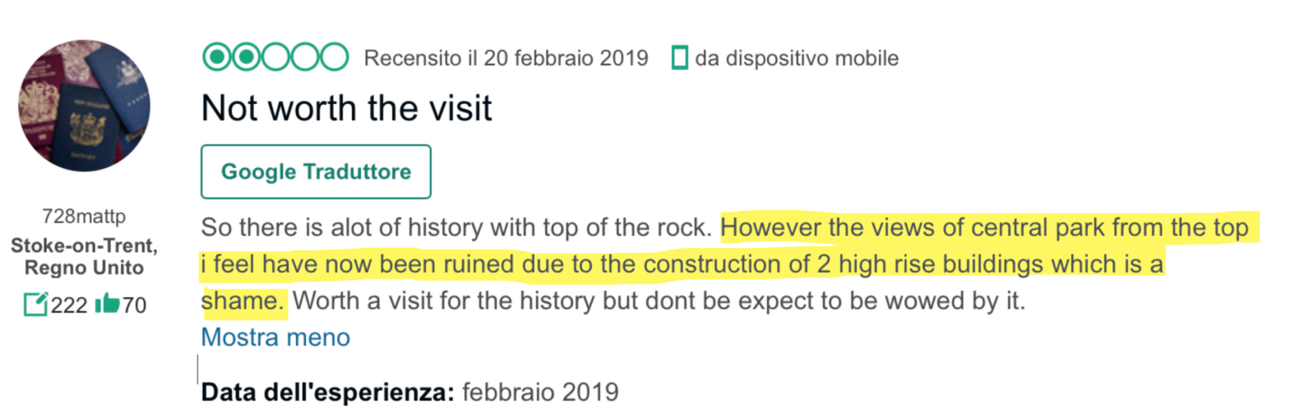
TRIPADVISOR PROBLEM 1
The View
6

Slide 7
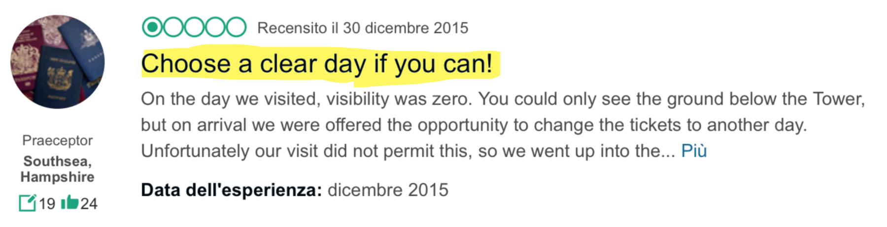
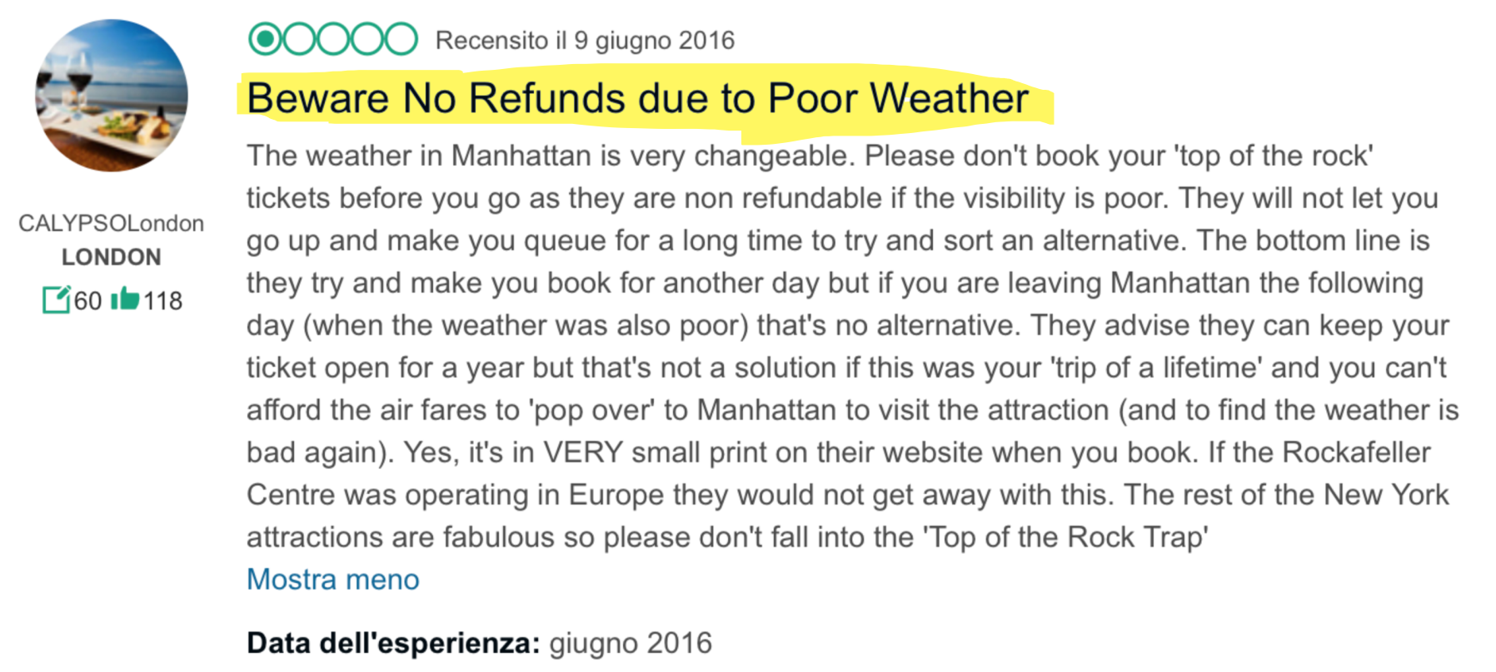
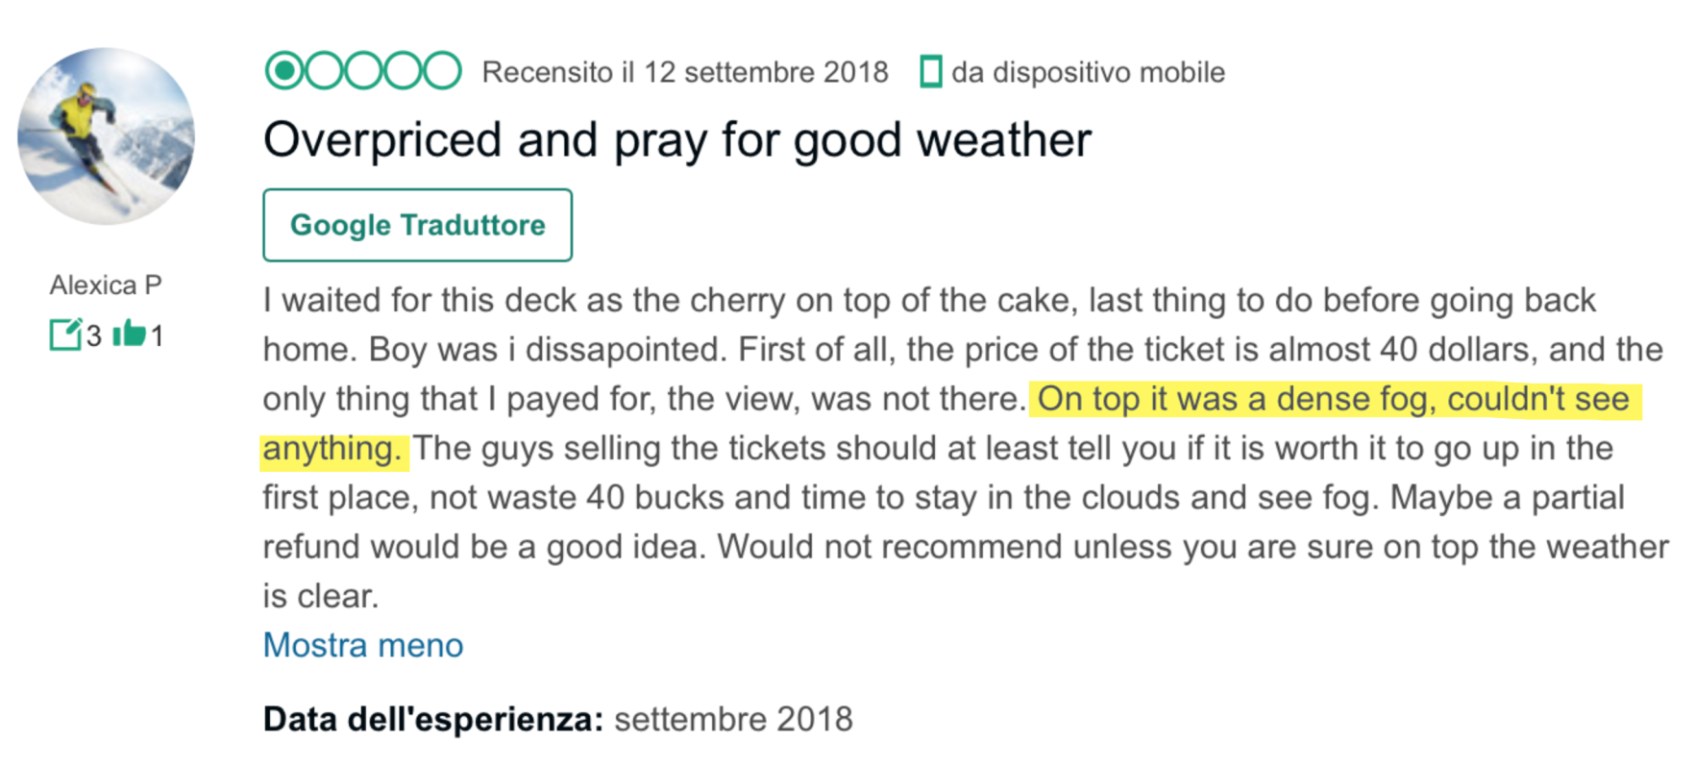
TRIPADVISOR PROBLEM 2
The Weather
7

Slide 8
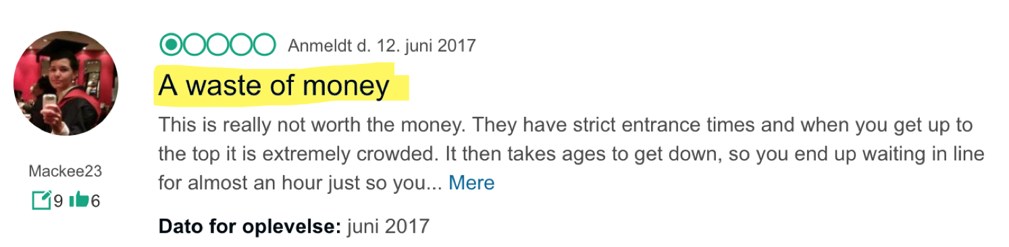
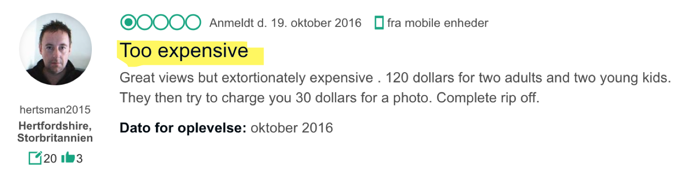
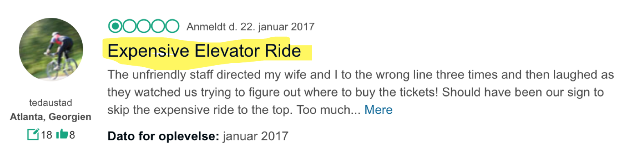
TRIPADVISOR PROBLEM 3
The Money / Value
8

Slide 9
ISSUES SUMMARY
The View
1.
Bad Weather
2.
The Money / Value
3.
Long Queue
4.
Rude Staff Members
5.

Slide 10

BUSINESS APPROACH

Slide 11




TARGET GROUP
TOURIST
Around 60 million tourist in NY every year.
Around 2.5 million visiting Top of The Rock
OUR OFFER
“Must Do” experience in New York
Unique photos possibility
Knowledge of New York
GETTING CUSTOMERS MORE INVOLVED
Making each visit different
Unique features through the app
Make customers want to return

Slide 12

MARCUS HERNANDO
Marcus is a spanish college graduate who is 32 year old, and visiting NY for the first time with his girlfriend.
INTERESTS:
World awareness
Photography
Social Media
GOALS:
Become manager of his division
Propose to his girlfriend
AMBITION
CHARISM
TEAM
WORK
INNOVATE

Slide 13
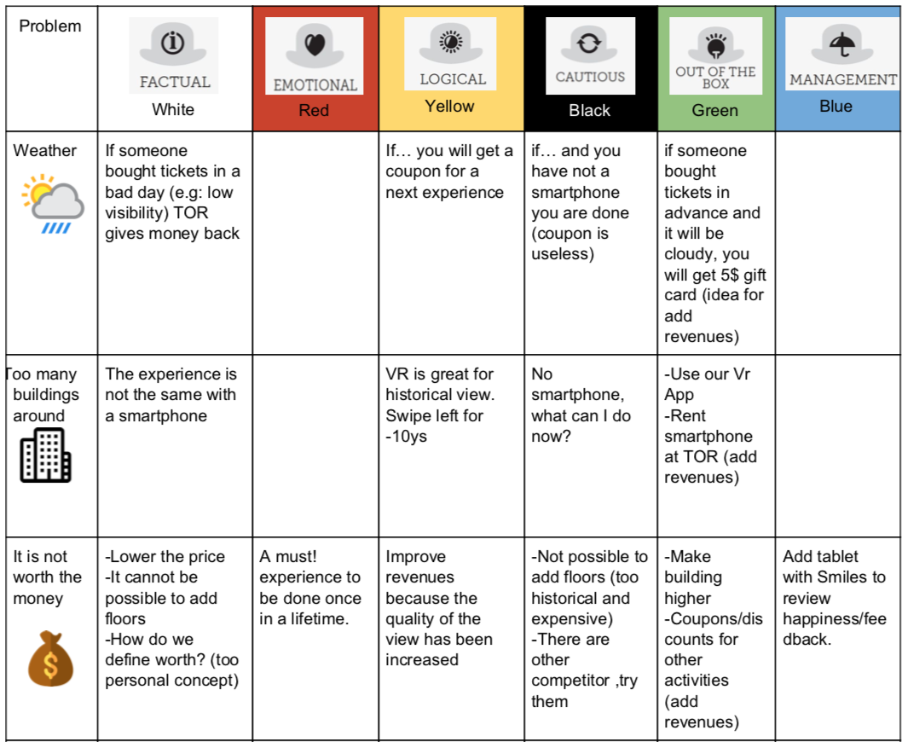
THINKING HATS

Slide 14
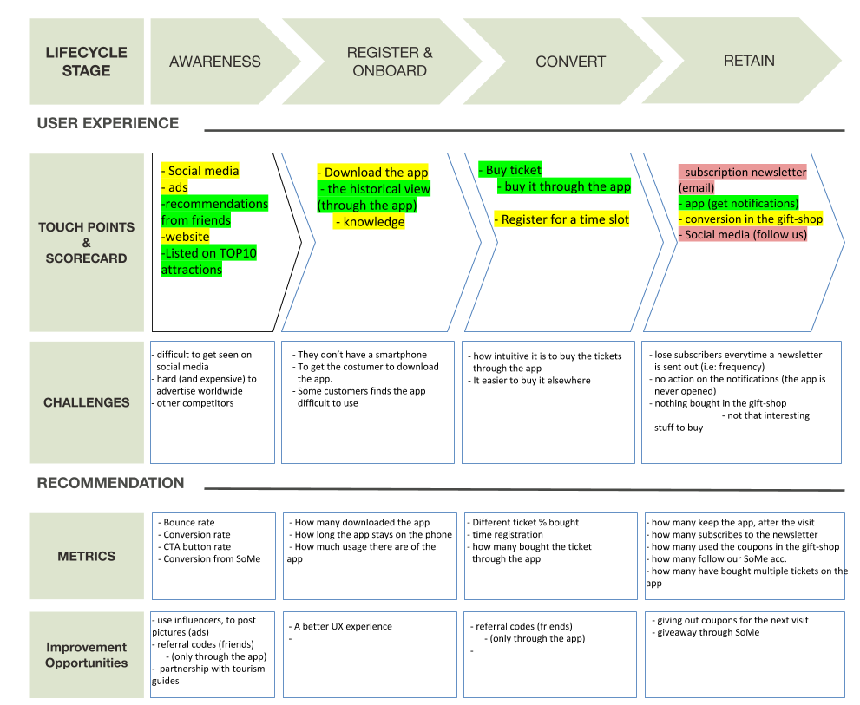
CUSTOMER JOURNEY MAP

Slide 15


DATA ANALYSIS
Notes:
After the business one, we tried an analytical approach in order to face our problem from a different prospective

Slide 16
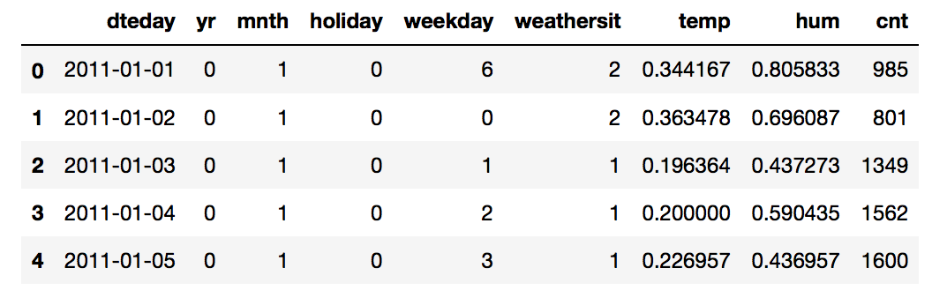
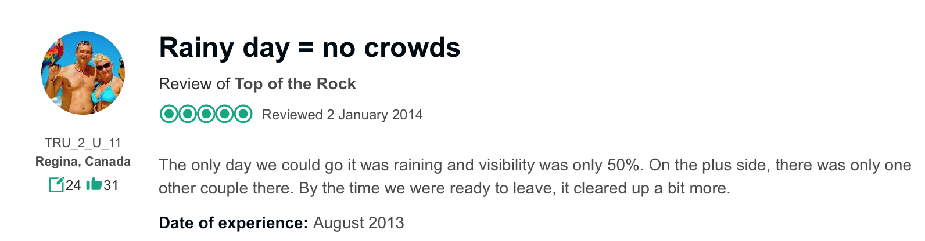


THE DATABASE CHOICE
16
Notes:
The first task. We had to face was the one ralated to the need to find a db with trends and patterns that can be reconduct to tor case.
This one has data gatehered in a 2 yeras period, group by day, with infos about the number of bike rented on each day and the weather condition clustered in that particular day.
We made the assuption
Our goal is to use the weather condition to predict the cnt or at least the affluence in order to personalise some offert with coupons in particular days or at least we can organize better the situation

Slide 17


DATA ANALYSIS PROCESS
EXPLORATION
PRE-PROCESSING
Explore and visualize the data for a better understanding of what we have.
Manipulating data to extract useful features and Clustering
TUNING
IMPLEMENTATION
Try to get the best from our algorithm through the choice of the best parameter.
Going deep into the phase where we code and test our algorithm

Slide 18
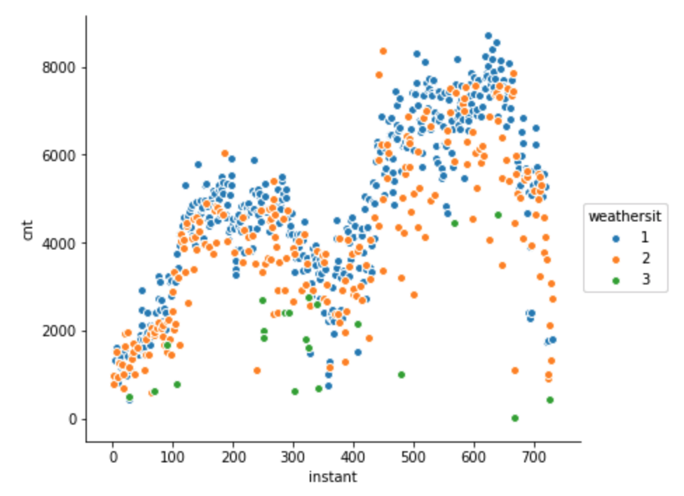
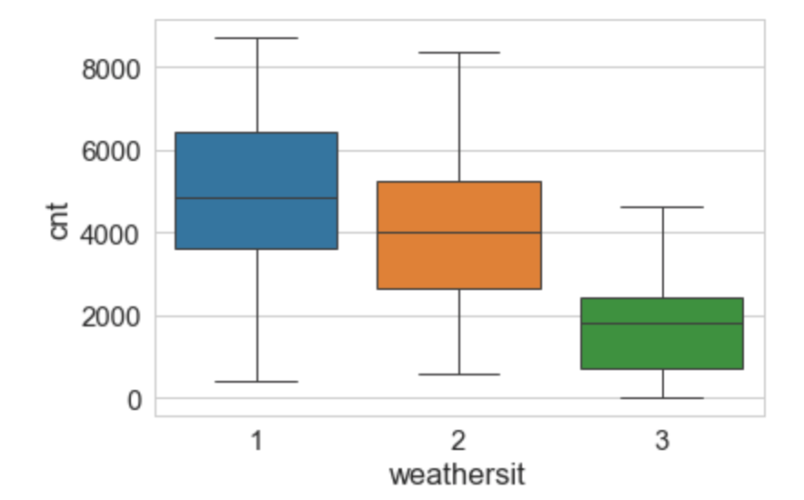
EXPLORATION
WEATHER LEGEND:
sunny
cloudy
rainy
Distribution of number of rentals a day during the whole period, colored by weather
Distribution and Density of Numbers of rentals with boxplots

Slide 19
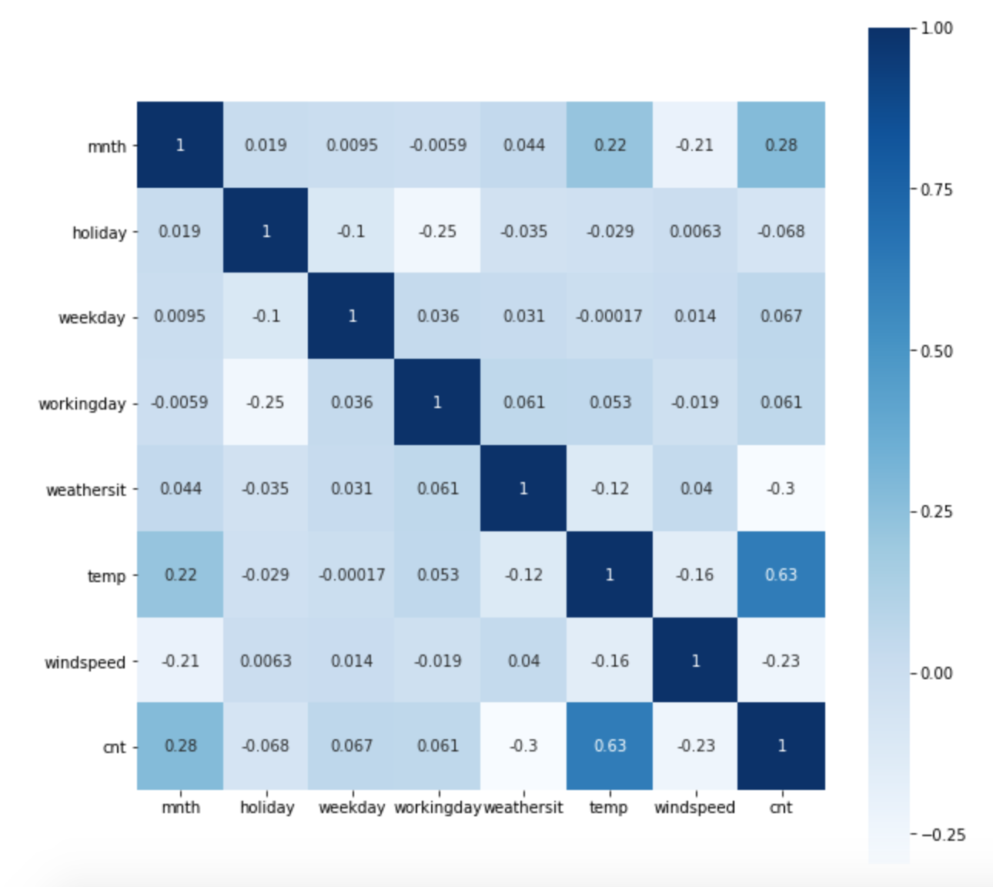
EXPLORATION PT.2
Correlation Matrix

Slide 20
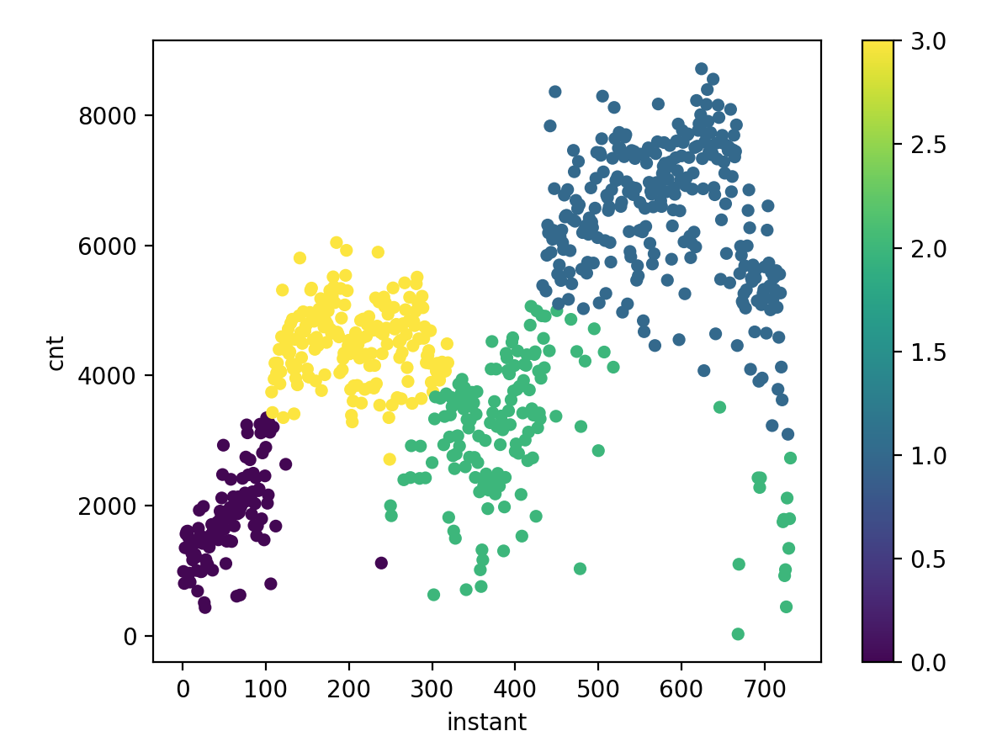
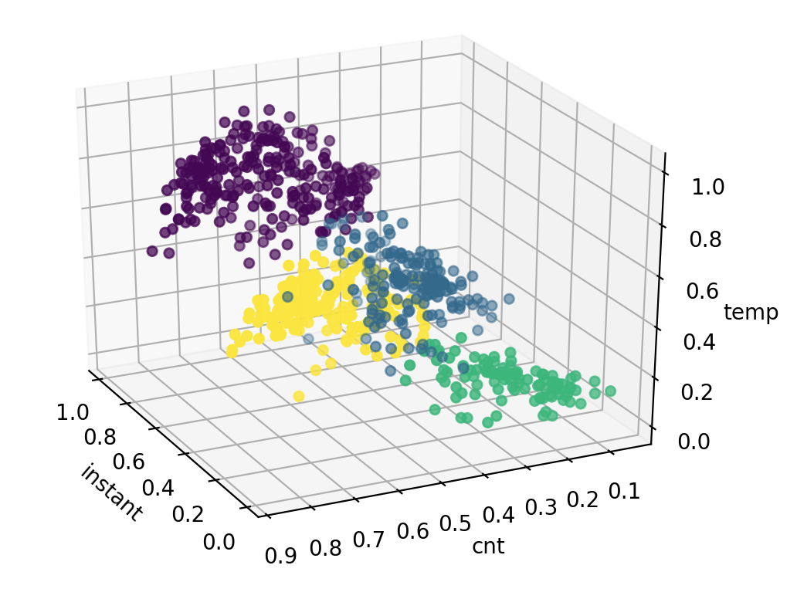
PRE-PROCESSING- CLUSTERING
K – Means ( 4 clusters )

Slide 21
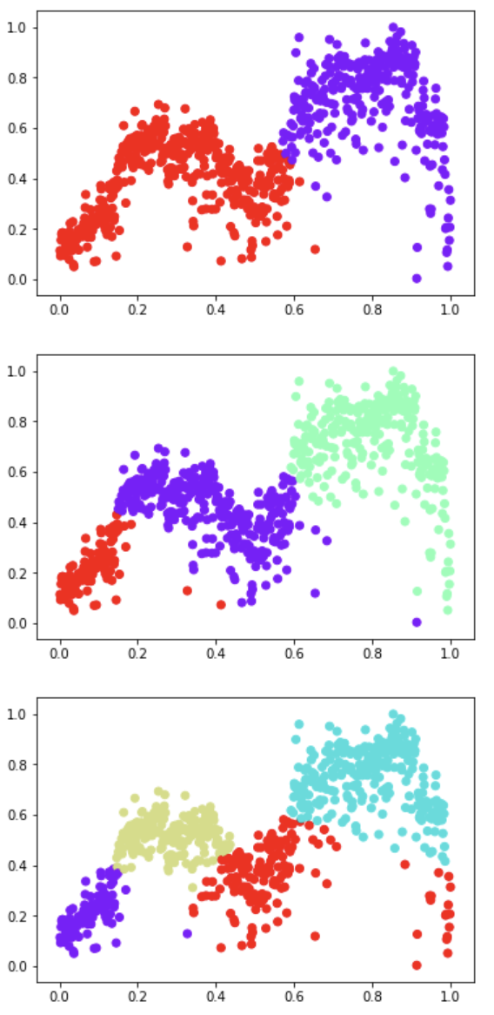
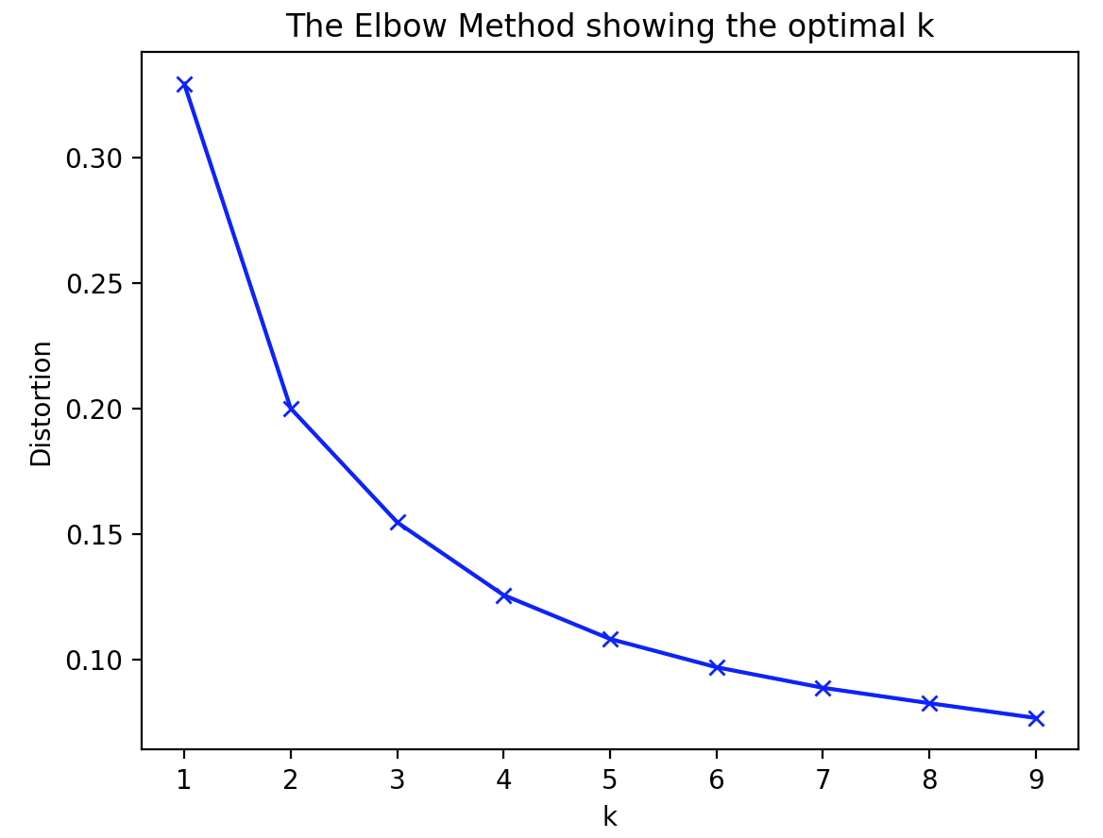
EVALUATING CLUSTERING
k = 2
k = 3
k = 4

Slide 22
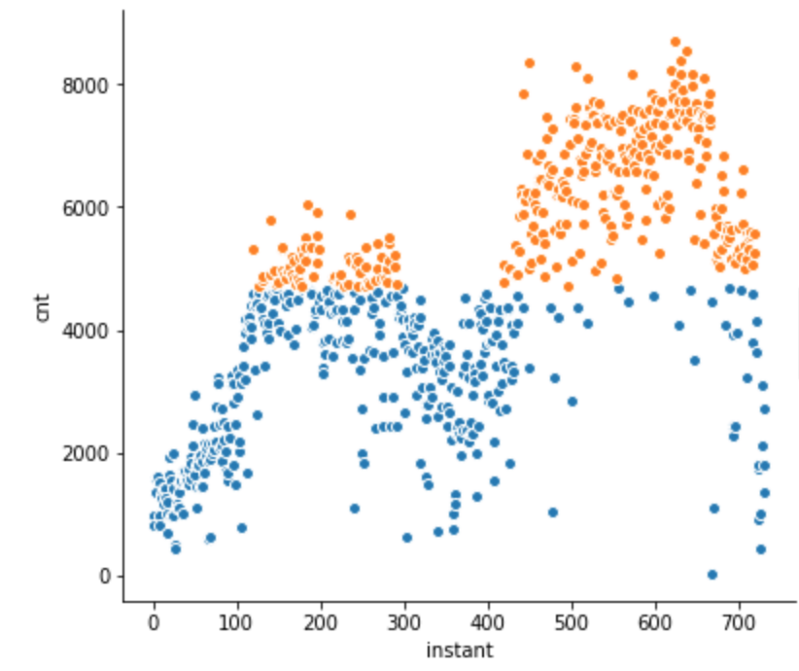
CLUSTERING PT.3
N=4700
Adding a threshold manually

Slide 23
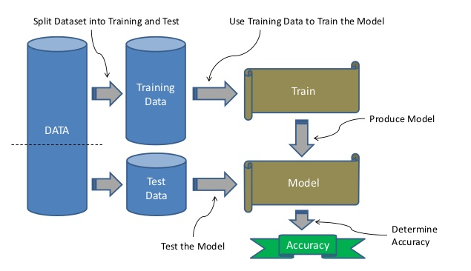
IMPLEMENTATION

Slide 24
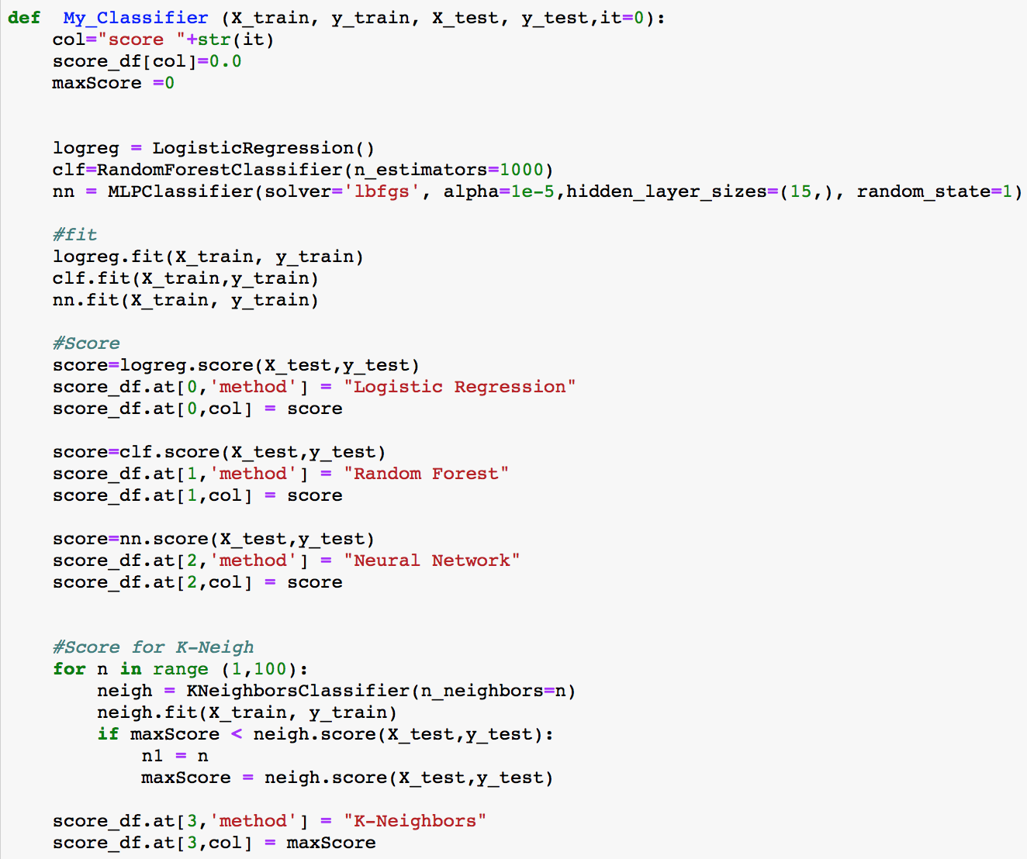
IMPLEMENTATION PT.2
code snippet:

Slide 25
MODELS IMPLEMENTED
K-Neighbors
Accuracy: 0.8797
Random Forest
Linear Regression
Accuracy: 0.9125
R Squared : 0.8158
Neural Network
Accuracy: 0.868
Notes:
Perché fanno così cagare e perché K-neighbors alla fine fa meglio di tutti?

Slide 26
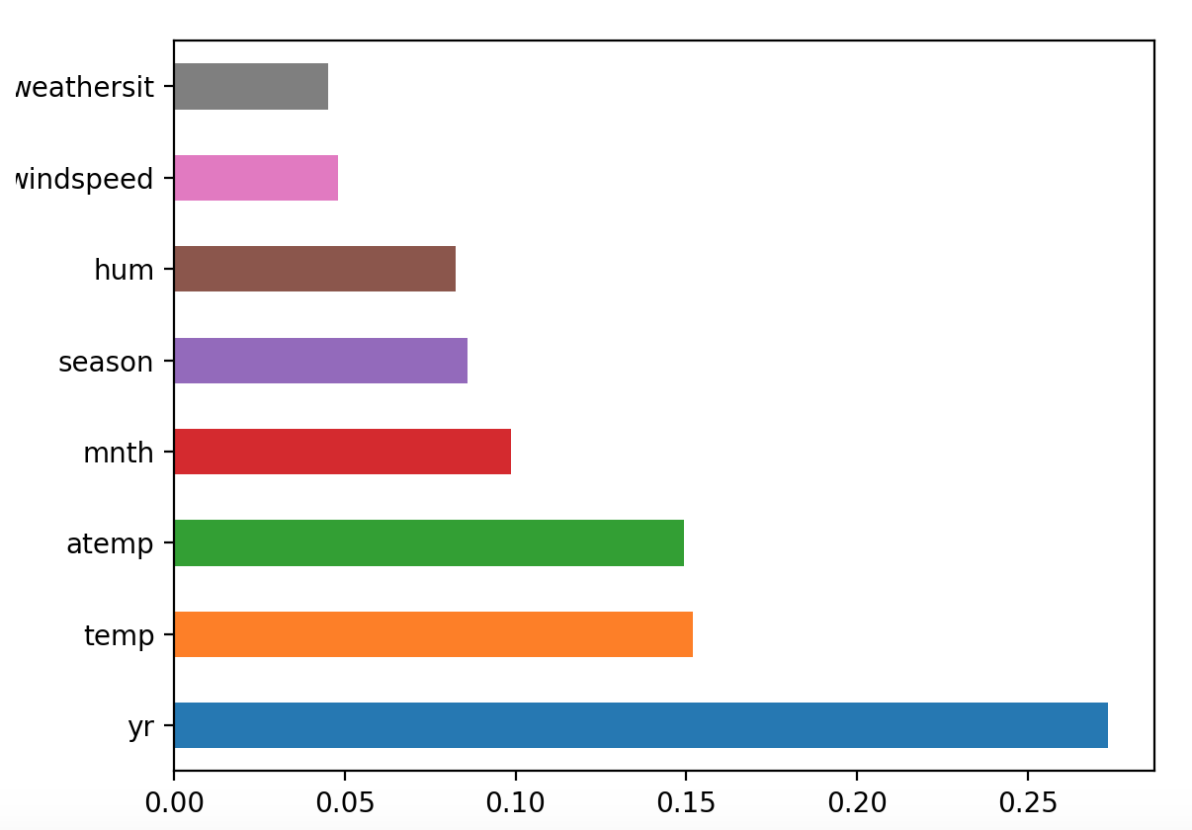
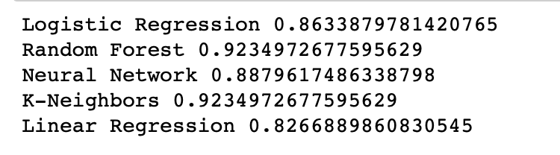
TUNING
Prediction using most effective features
Feature importance
Notes:
Tuning generale per tutti gli algoritmi

Slide 27
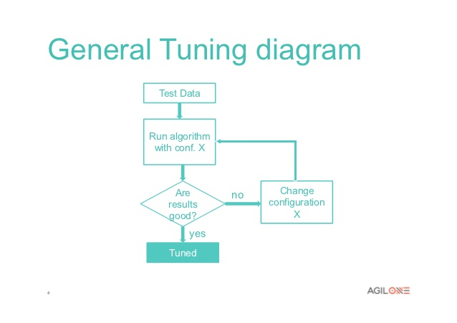
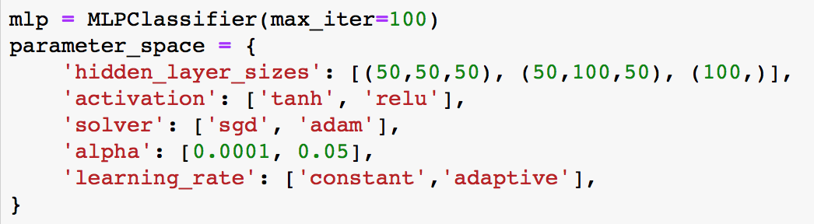
TUNING PT.2
Notes:
Tuning specifico degli hyperparametri del nn (fatto sempre su test non su valutazione (da non dire))

Slide 28
IN A NUTSHELL
Explore and visualize the data
1
Implement different algorithms and methods
2
Find the most important features and perform tuning
3
K Means results to be the best, with an accuracy of 92%
4

Slide 29
PROTOTYPE

Slide 30
SOLUTION
Quick reminder - Key Problems
The view
The weather
The money / value
Long queue
Rude staff
30

Slide 31
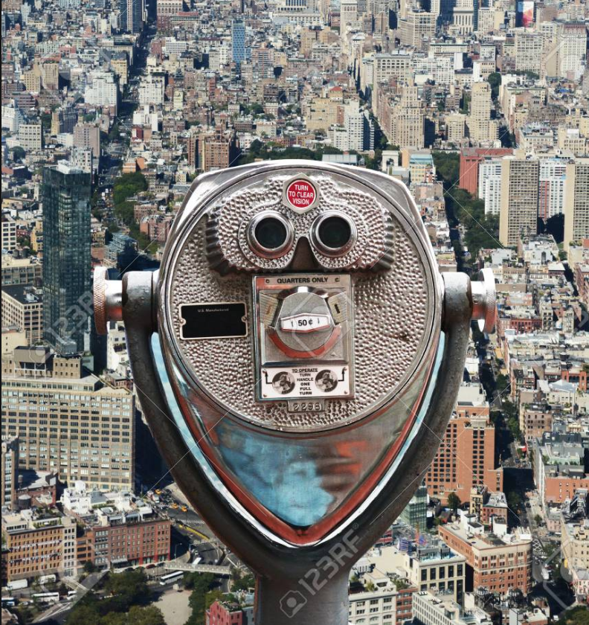
SOLUTION PT.2
What does our solution consist of ?
Extensions
The website
The app & The binoculars
Virtual Reality
Binocular
31

Slide 32
THE WEBSITE
DEMO

Slide 33
THE APPLICATION
DEMO

Slide 34
IN A NUTSHELL
What is possible with our solution?
Explore and visualize the data
1
See manhattan even in bad weather
1
See through the history of manhattan
2
Create more value for the same price
3

Slide 35
THANK YOU FOR YOUR ATTENTION!😃

